Slide 1
CIS041-3 Advanced Information Technology
Information Retrieval 1
Inverted index & Boolean mode
Gangmin Li
(Office hours: 13:00-17:00 every Friday)

Slide 2
What we have learnt
What is Information?
What is Information systems?
What is Information technology
Advanced information technology (2022)

Slide 3
Outline
Information seeking and Information Retrieval
Boolean model of information retrieval
Document representation:Term-document Matrix (incidence/occurrence matrix)
Document indexing
Processing Boolean Queries
Vector-space retrieval models
Evaluation and interface issues

Slide 4
1. Information seeking and Information Retrieval
Where the story starts

Slide 5
Information Seeking
People need information for decision making.
The field of Information Seeking is studied in Information Science which is concerned with determining user’s information needs, searching behaviour and subsequent use of information.
Information seeking is purposive seeking of Information to satisfy some goal. Wilson (2000)

Slide 6
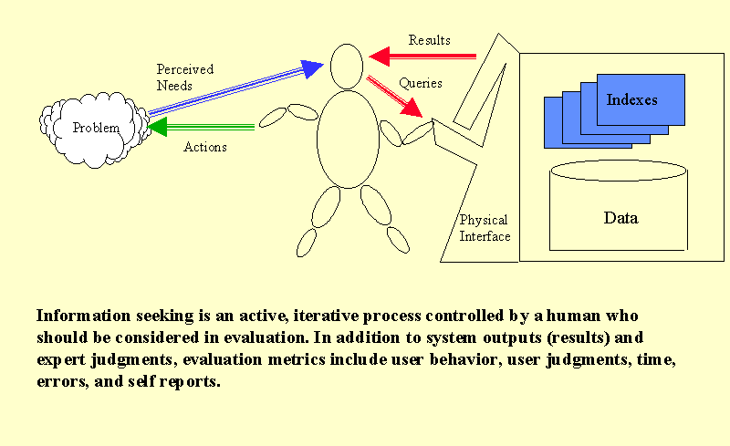
Information Seeking Process
Information Seeker

Slide 7
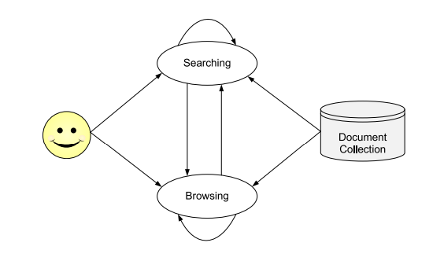
Information seeking behaviours
There are two types of Information seeking
Compulsory Information seeking (Searching)
Discretionary Information Seeking (Browsing)

Slide 8
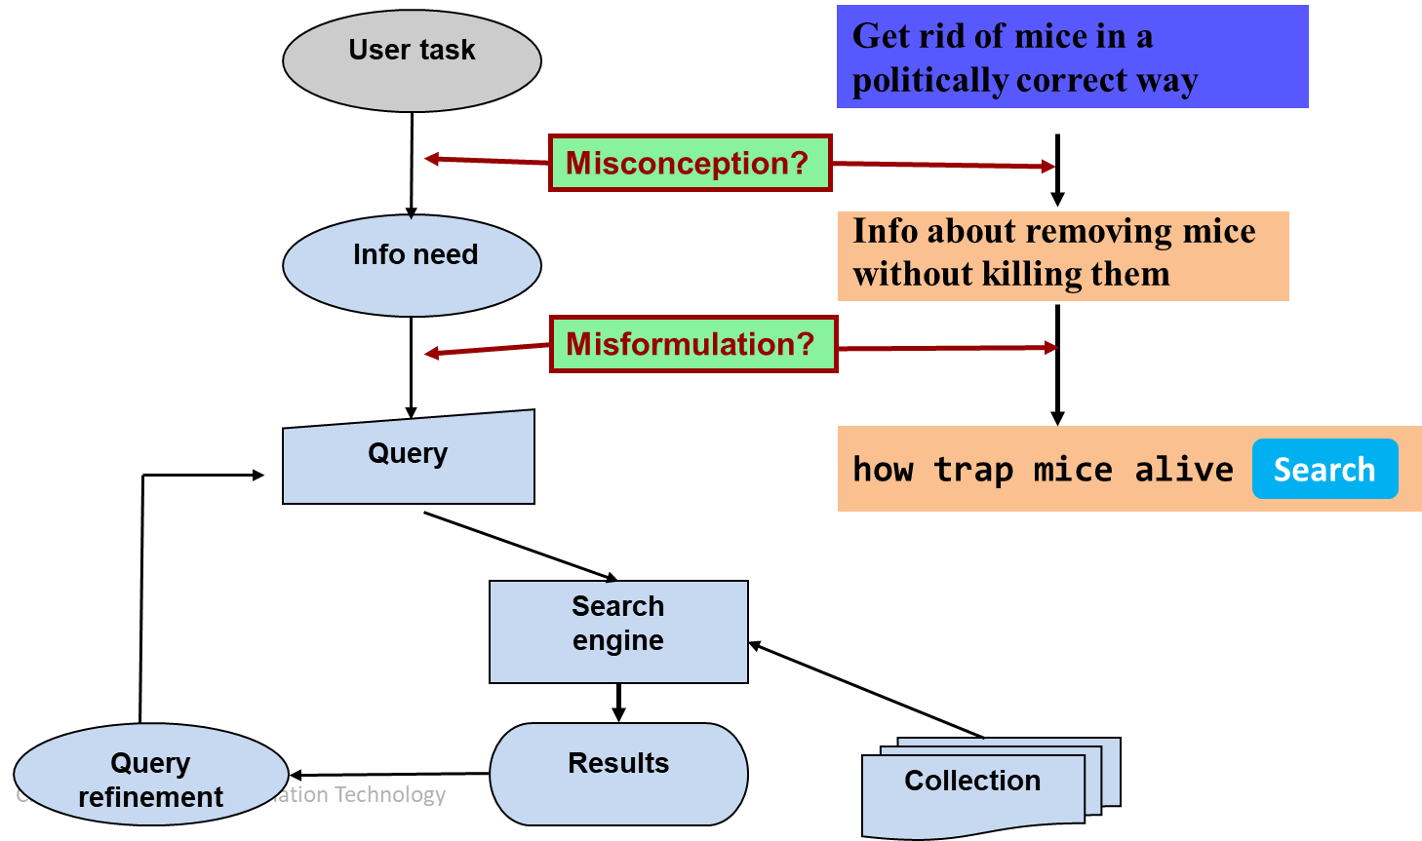
The Classical search model

Slide 9
Information Retrieval
A broad area of Computer Science focused on providing the users (information seeker) with easy access to information of their interest.
Satisfy users Information seeking.
Deals with the representation, storage, organization of, and access to information items such as documents, Web pages, online catalogues, structured and semi-structured records, multimedia objects.

Slide 10
Definition of information Retrieval
Manning et al, 2008:
Information retrieval (IR) is finding material (usually documents) of an unstructured nature (compare with Data in RDMS) that satisfies an information need from within large collections (usually stored on computers).

Slide 11
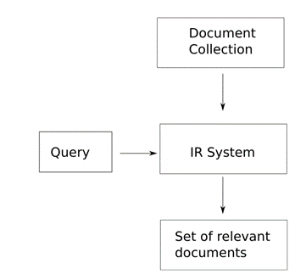
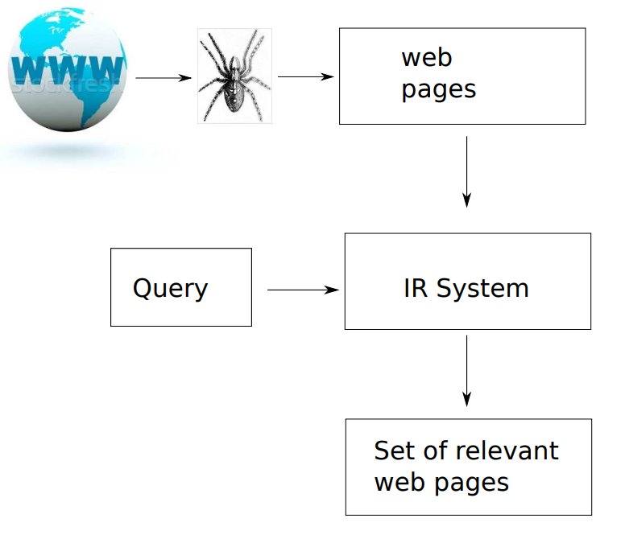
Two major types IR today
IR from Doc collection
IR from Web

Slide 12
The goal of IR
Early goals of the IR: indexing text and searching for useful documents in a collection
Nowadays, research in IR includes: Modelling, Web search, text classification, systems architecture, user interfaces, data visualization, filtering and languages
Search item includes: sound, images, video and objects

Slide 13
The IR Problem
The primary goal of an IR system is to retrieve all the documents (unstructured) that are relevant to a user query while retrieving as few nonrelevant documents as possible.
The notion of relevance is of central importance in IR. But, define relevance is hard:
Understand the user’s needs (How?)
Interpreted user’s query (How?)
IR system’s performing (accuracy? Efficiency? Accessibility? Economic?)

Slide 14
Information scarcity vs. information abundance
Information scarcity problem (or needle-in-haystack problem): hard to find rare information
Lord Byron’s first words?
. . . when a servant had spilled an urn of hot coffee over his legs, he replied to the distressed inquiries of the lady of the house, ’Thank you, madam, the agony is somewhat abated.’ [not Lord Byron, but Lord Macaulay]
Information abundance problem (for more clear-cut information needs): redundancy of obvious information
What is toxoplasmosis?

Slide 15
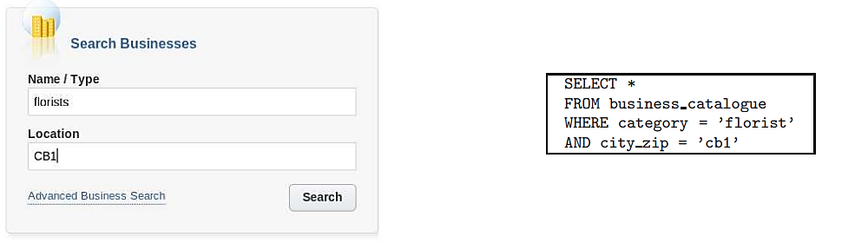
Structured vs Unstructured Data
Unstructured data means that a formal, semantically overt, easy-for-computer structure is missing.
In contrast to the rigidly structured data used in DB style searching (e.g. product inventories, personnel records)
This does not mean that there is no structure in the data
Document structure (headings, paragraphs, lists. . . )
Explicit markup formatting (e.g. in HTML, XML. . . )
Linguistic structure (latent, hidden)

Slide 16
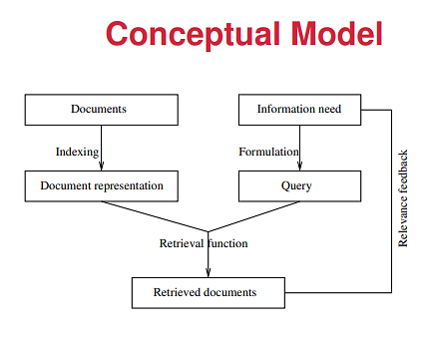
IR Solution model
Documents need to be transformed into document representations (Indexing)
Users formulate a Query from their information need
Document representations and query are machine processable (Retrieval)

Slide 17
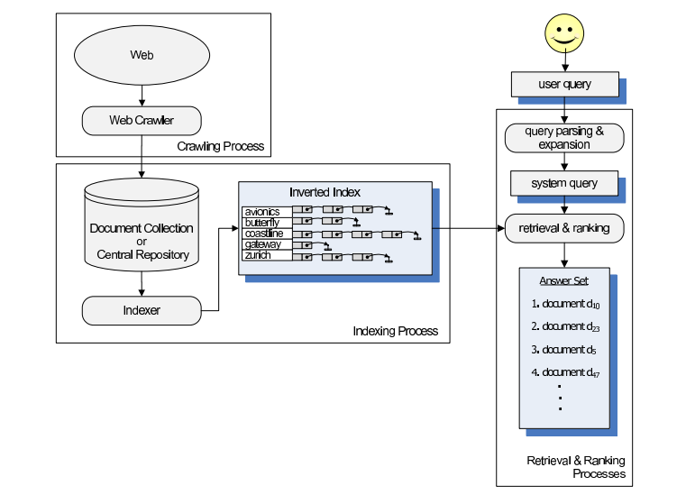
An Architecture of Web IR System

Slide 18
Evaluation of IR
How well has the system performed?
How good the IR is?
What to measure? (Recall and precision)
Easy to use?
Capacity?
Efficacity?
Ultimate: information seeker’s Satisfaction!

Slide 19
Precision and Recall
The effectiveness of an IR system (i.e., the quality of its search results) is determined by two key statistics about the system’s returned results for a query:
Precision: What fraction of the returned results are relevant to the information need?
Recall: What fraction of the relevant documents in the collection were returned by the system?
What is the best balance between the two?
Easy to get perfect recall: just retrieve everything
Easy to get good precision: retrieve only the most relevant

Slide 20



IR Technologies Today
Web search
Search ground are billions of documents on millions of computers
issues: spidering; efficient indexing and search; malicious manipulation to boost search engine rankings, profit-driven rankings etc.
Enterprise and institutional search
Company’s documentation, patents, research articles often domain-specific
Centralised storage; dedicated machines for search.
Most prevalent IR evaluation scenario: US intelligence analyst’s searches

Slide 21

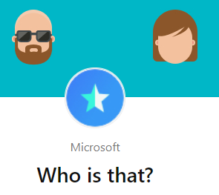
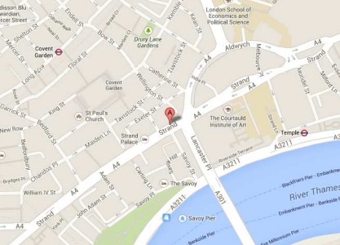
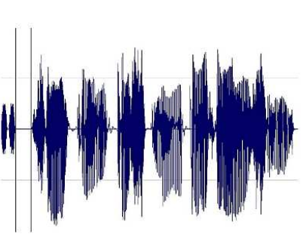
Non-textual search

Slide 22
Term-document Matrix (incidence/occurrence) matrix
2. Boolean model of Information Retrieval
How to represent document (text, video and audio) and make it can be searchable?

Slide 23
Boolean Retrieval model
Sec. 1.3
The Boolean retrieval model is being able to ask a query that is a Boolean expression:
Boolean expression are queries using AND, OR and NOT to join query terms
Views each document as a set of words
Exact match : document matches condition or not.
Primary commercial retrieval tool for 3 decades.
Many search systems you still use are Boolean:
Email, library catalog, macOS Spotlight

Slide 24
The Example Problem
Sec. 1.1
Which plays of Shakespeare contain the words Brutus AND Caesar but NOT Calpurnia?
One could grep all of Shakespeare’s plays for Brutus and Caesar, then strip out plays containing Calpurnia
Why is that not a good answer?
Slow (for large corpora)
NOT Calpurnia is non-trivial
Other operations not feasible (e.g., find the word Romans near countrymen)
Ranked retrieval (best documents to return)
Notes:
Grep is line-oriented; IR is document oriented.

Slide 25
Term-document Incidence Matrix
Sec. 1.1
Document
Term
Term-document matrix: the simplest way to represent
the documents that contain each word of the vocabulary
1 if play contains word, 0 otherwise

Slide 26
Incidence vectors
Sec. 1.1
Incidence vectors: a 0/1 vector for each term.
To answer query: Which plays of Shakespeare contain the words Brutus AND Caesar but NOT Calpurnia?
take the vectors for Brutus, Caesar and Calpurnia (complemented) ➔ bitwise AND.
110100 AND
110111 AND
101111 =
100100

Slide 27
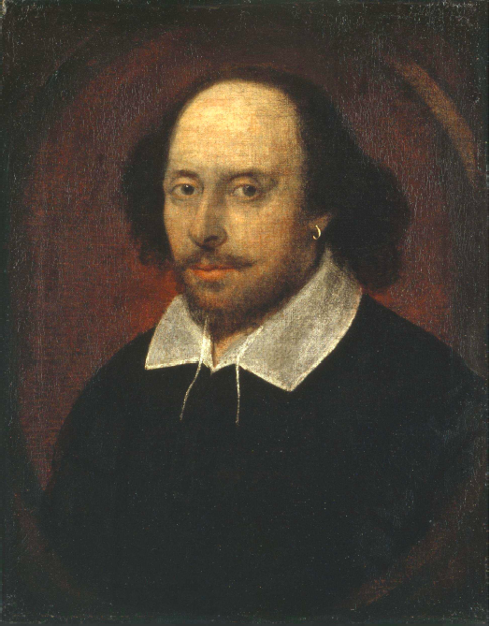
Answers to the query
Sec. 1.1
Antony and Cleopatra, Act III, Scene ii
Agrippa [Aside to DOMITIUS ENOBARBUS]: Why, Enobarbus,
When Antony found Julius Caesar dead,
He cried almost to roaring; and he wept
When at Philippi he found Brutus slain.
Hamlet, Act III, Scene ii
Lord Polonius: I did enact Julius Caesar I was killed i’ the
Capitol; Brutus killed me.
Notes:
Wikimedia commons picture of Shake

Slide 28
Problem with term-document matrix
Sec. 1.1
Sparsity
Consider N = 1 million documents, each with about 1000 words.
Avg 6 bytes/word including spaces/punctuation
6GB of data in the documents.
Say there are M = 500K distinct terms among these.

Slide 29
The Sparsity of the matrix
Sec. 1.1
500K x 1M matrix has half-a-trillion 0’s and 1’s.
But it has no more than one billion 1’s.
matrix is extremely sparse.
What’s a better representation?
E.g. Term-document Matrix with number of occurrences
Why?
Notes:
We have 1m documents each has 1000 words. The total words are only 1000X1m = 1b. So there are Maximum 1b 1’s
The total size of the term and doc is 500k X 1m = 500billion
The percentage of 1’s is 1/500. So it is sparse

Slide 30
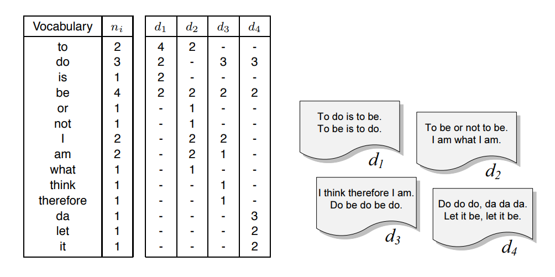
Term-document Matrix with number of occurrences
The solution is to associate a list of documents with each word. “to (2) [d1:4, d2:2]”.
The set of all those lists is called the occurrences

Slide 31
The Inverted Index
The key data structure for Boolean IR mode

Slide 32
Inverted index (concept)
Sec. 1.2
For each term t, a list of all documents that contain t is called inverted index.
The inverted index consists of
a dictionary of terms (also: lexicon, vocabulary)
and a postings list for each term, i.e., a list that records which documents the term occurs in.
Brutus
1
2
4
11
31
45
173
174
Caesar
1
2
4
5
6
16
57
132
Calpurnia
2
31
54
101
What happens if the word Caesar is added to document 14?

Slide 33
Inverted index (variable-size)
Sec. 1.2
We need variable-size postings lists
On disk, a continuous run of postings is normal and best
In memory, can use linked lists or variable length arrays
Some tradeoffs in size/ease of insertion
Posting
Brutus
1
2
4
11
31
45
173
174
Caesar
1
2
4
5
6
16
57
132
Calpurnia
2
31
54
101
Dictionary
Postings
Sorted by docID (more later on why).
Notes:
Linked lists generally preferred to arrays
Dynamic space allocation
Insertion of terms into documents easy
Space overhead of pointers

Slide 34

Inverted index Construction
Sec. 1.2
Documents to
be indexed
Friends, Romans, countrymen.
Tokenizer
Token stream
Friends
Romans
Countrymen
Linguistic modules
Modified tokens
friend
roman
countryman
Indexer
friend
2
4
roman
1
2
Inverted index
countryman
13
16
Notes:
Document icons from free icon set: http://www.icojoy.com/articles/44/

Slide 35
Inverted index construction
Sec. 1.2
Documents to
be indexed
Friends, Romans, countrymen.
Tokenizer
Token stream
Friends
Romans
Countrymen
More on
these later.
Linguistic modules
Modified tokens
friend
roman
countryman
Indexer
friend
2
4
roman
1
2
Inverted index
countryman
13
16
Notes:
Document icons from free icon set: http://www.icojoy.com/articles/44/

Slide 36
Initial stages of text processing
Tokenization
Cut character sequence into word tokens
Deal with “John’s”, a state-of-the-art solution
Normalization
Map text and query term to same form
You want U.S.A. and USA to match
Stemming
We may wish different forms of a root to match
authorize, authorization
Stop words
We may omit very common words (or not)
the, a, to, of

Slide 37
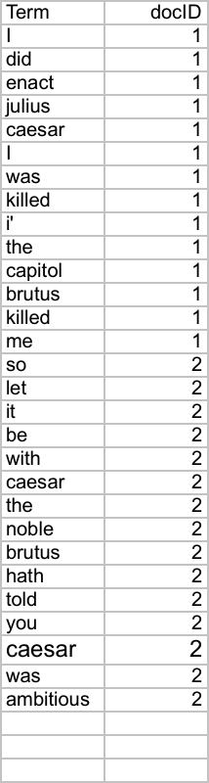
Indexer steps: Token sequence
Sec. 1.2
Sequence of (Modified token, Document ID) pairs.
Doc 1
Doc 2
I did enact Julius
Caesar I was killed
i’ the Capitol;
Brutus killed me.
So let it be with
Caesar. The noble
Brutus hath told you
Caesar was ambitious

Slide 38
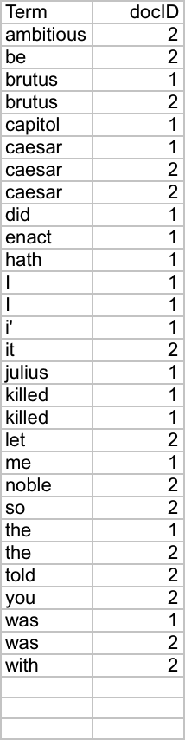
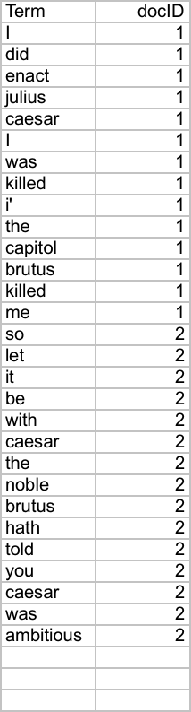
Indexer steps: Sort
Sec. 1.2
Sort by terms
At least conceptually
And then docID
Core indexing step

Slide 39
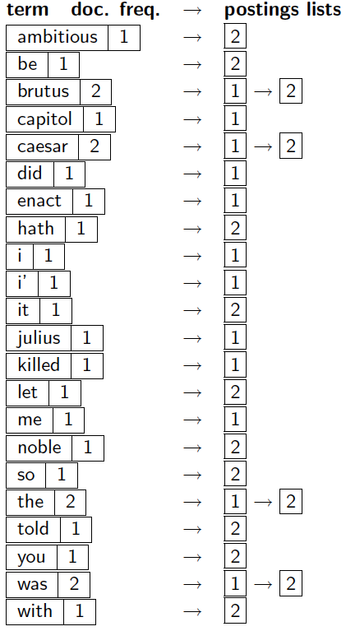
Indexer steps: Dictionary & Postings
Sec. 1.2
Multiple term entries in a single document are merged.
Split into Dictionary and Postings
Doc. frequency information is added.
Why frequency?
Will discuss later.

Slide 40
Where do we pay in storage?
Sec. 1.2
(Basic inverted index)
Lists of docIDs
Terms and counts
IR system implementation
How do we index efficiently?
How much storage do we need?
Pointers

Slide 41
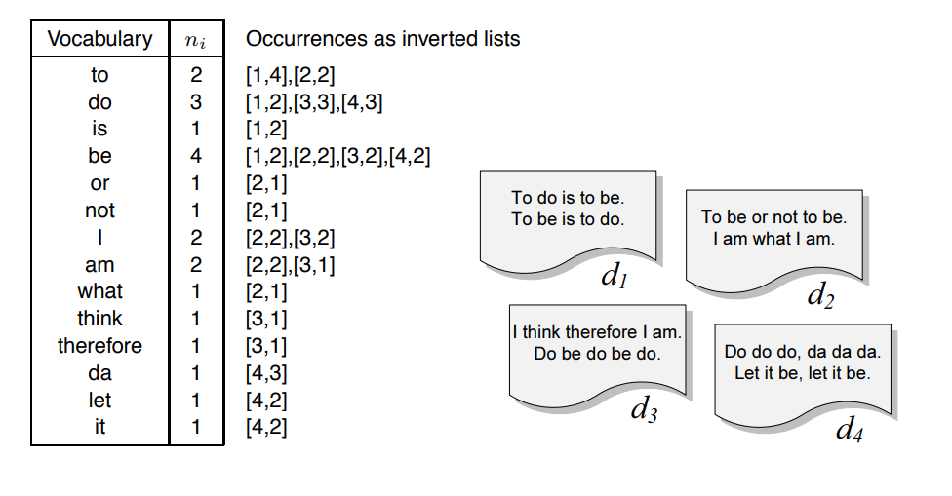
Other (Improved) inverted index
Add Occurrences into inverted lists

Slide 42
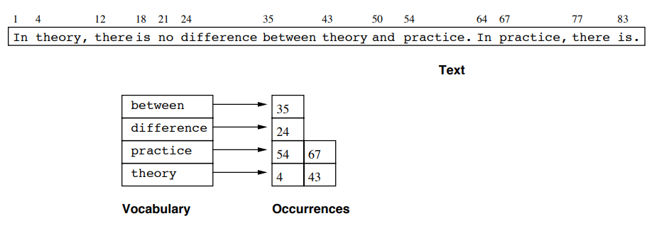
Full Inverted Indexes
The basic index is not suitable for answering phrase or proximity queries. We need to add the positions of each word in each document to the index (full inverted index)

Slide 43
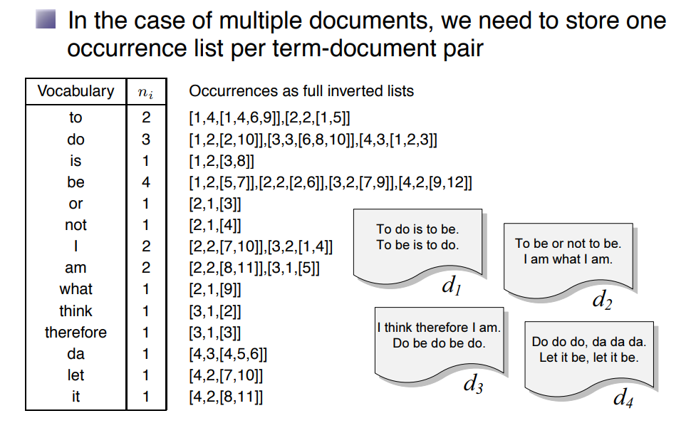
Full Inverted Indexes

Slide 44
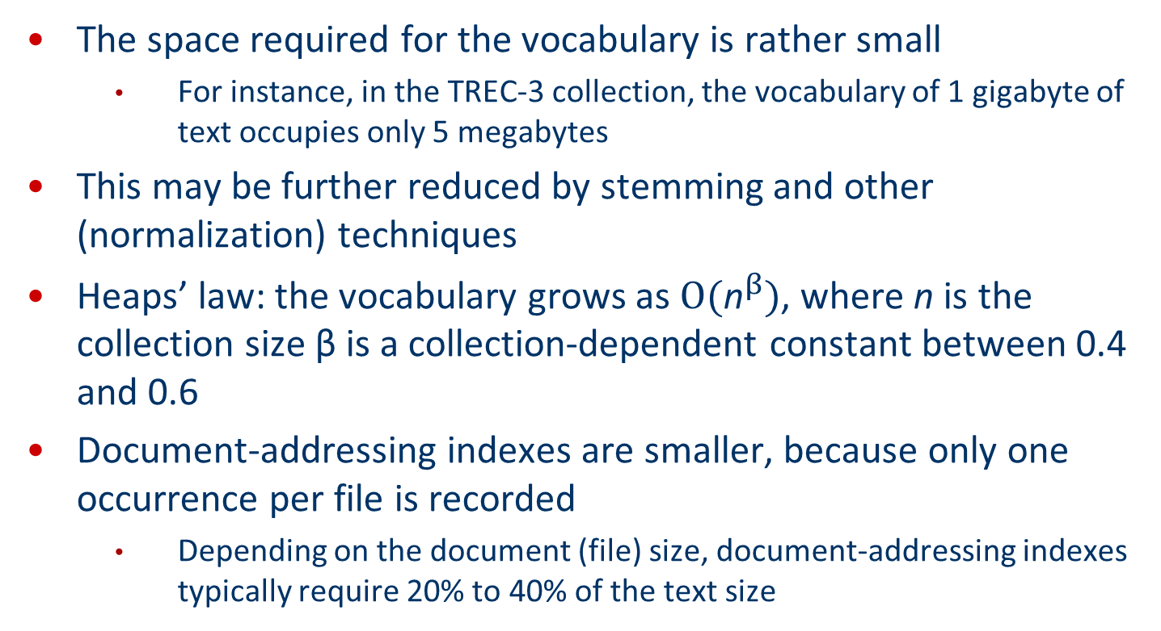
Full Inverted Indexes
The space required for the vocabulary is rather small
For instance, in the TREC-3 collection, the vocabulary of 1 gigabyte of text occupies only 5 megabytes
This may be further reduced by stemming and other (normalization) techniques
Heaps’ law: the vocabulary grows as $Ο({\text{n}}^{β})$, where n is the collection size β is a collection-dependent constant between 0.4 and 0.6
Document-addressing indexes are smaller, because only one occurrence per file is recorded
Depending on the document (file) size, document-addressing indexes typically require 20% to 40% of the text size

Slide 45
Query processing with an inverted index
How inverted index can be used to answer a query?

Slide 46
Query processing: Brutus AND Caesar
Sec. 1.3
Step1. locate query terms in the Dictionary
(suppose dictionary is built – next section)
Locate Brutus in the Dictionary and retrieve its postings (the inverted lists of Brutus).
Locate Caesar in the Dictionary and retrieve its postings (the inverted lists of Caesar)
Step2. “Merge” the two postings
(intersect the document sets):
2
4
8
16
32
64
128
Brutus
1
2
3
5
8
13
21
34
Caesar

Slide 47
The merge
Sec. 1.3
Merge: Walk through the two postings simultaneously, in time linear in the total number of postings entries
X
2
4
8
16
32
64
128
Brutus
Y
1
2
3
5
8
13
21
34
Caesar
If the list lengths are and y, the merge takes O(x+y)
operations.
Crucial: postings sorted by docID.

Slide 48
The merge (intersecting)
Sec. 1.3
Walk through the two postings simultaneously, in time linear in the total number of postings entries
X
2
4
8
16
32
64
128
Brutus
Y
1
2
3
5
8
13
21
34
Caesar
2
8
If the list lengths are and y, the merge takes O(x+y)
operations.
Crucial: postings sorted by docID.

Slide 49
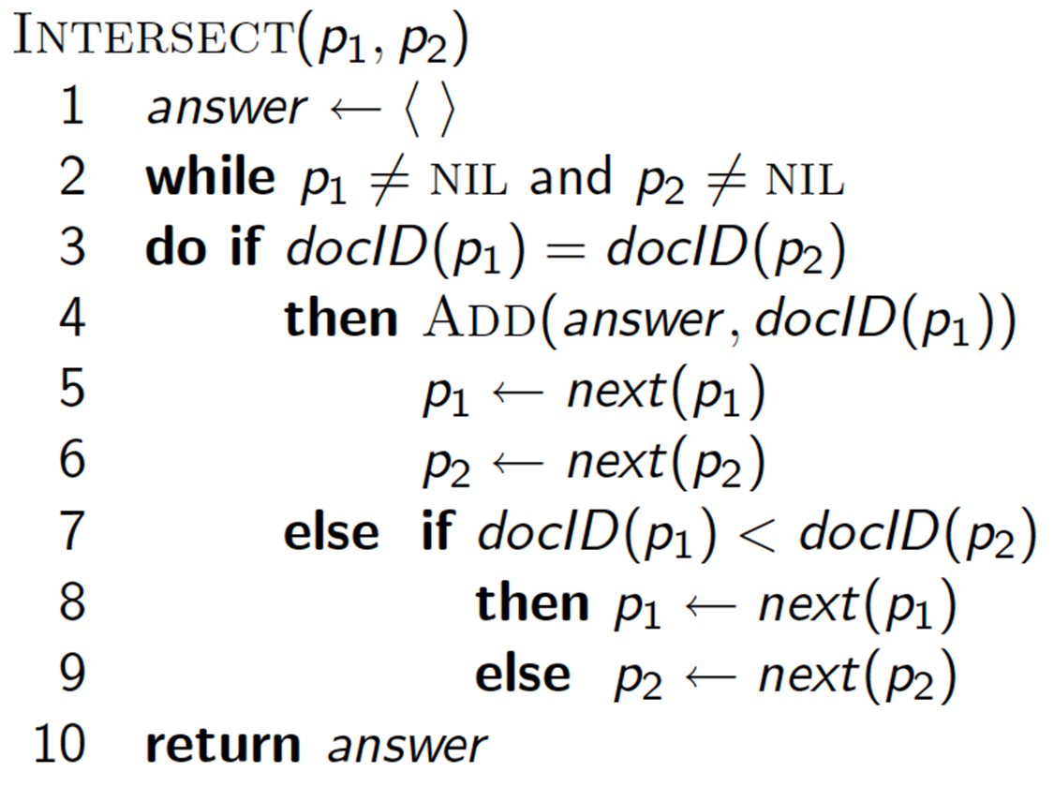
A “merge” algorithm: Intersecting two postings lists

Slide 50
Indexing
How do we build a inverted index?
The general Inverted index construction process

Slide 51
Indexing
Speed up search: for a given large collection of document
The index is a data structure built from text. Use index we can process queries and return documents
Extract meaningful terms and record their occurrence in an inverted index
Terms are strings of (possibly special) characters that are separated by
white spaces
punctuation and
other special characters

Slide 52
A 4-Steps Index construction Process
Indexing is usually performed in 4 steps:
1. Tokenisation
2. Stopword elimination
3. Stemming
4. Creation of the inverted index

Slide 53
Step 1: Tokenisation
Tokenisation: extracting all terms in all documents in the collection
A term might be a single word, but could also be a phrase
For example, ‘computer science’ could be one term, or split into the two terms ‘computer’ and ‘science’
We may not only consider the occurrence of a term, but also its position in the document
This builds our vocabulary (the set of all different terms found in all documents in the collection)

Slide 54
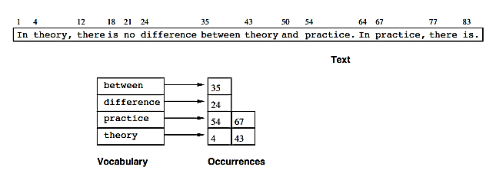
Tokenization Example

Slide 55
Step 2: Stopword Elimination
Frequent terms like “and”, “or” don’t bear any meaning for ad hoc retrieval (!!!)
This means we can eliminate these terms to keep our vocabulary small (usually stopword lists are applied)
Example
Apple has a built-in RSS reader. Kinda. While it’s not the dedicated RSS client that I hope they’ll build for iPhone, it helps a news junkie get his fix on a slow EDGE data connection.

Slide 56
Example
Apple has a built-in RSS reader. Kinda. While it’s not the dedicated RSS client that I hope they’ll build for iPhone, it helps a news junkie get his fix on a slow EDGE data connection.
After stopword elimination (and converting terms to lower case):
apple built-in rss reader kinda dedicated rss client hope build iphone helps news junkie get fix slow edge data connection

Slide 57
Step 3: Stemming
Stemming is the process of reducing terms to their stem base to increase the relevancy of documents
Stemming method for the English language: Porter algorithm
Several types of stemmers for different languages exist (for instance dictionary-based)
Further Resources
Online stemmer demo http://www.9ol.es/porter_js_demo.html
Porter Stemmer Page http://tartarus.org/~martin/PorterStemmer/

Slide 58
Stemming Example
computer −→ comput
computers −→ comput
computing −→ comput
→ Search for ’computer’ also finds documents with ’computers’ or ’computing’ (if we stem both the document and query terms)

Slide 59
Step 4: Inverted Indexing
The inverted indexing is to construct inverted lists
Inverted list: a “Term-oriented” basic data structures for each term in the vocabulary
Each Inverted list stores
The identifiers (IDs, e.g. URLs) of the documents that contain that term
All its positions in the document (if needed)
Further information as required

Slide 60
Example: Token sequence
Sec. 1.2
Sequence of (Modified token, Document ID) pairs.
Doc 1
Doc 2
I did enact Julius
Caesar I was killed
i’ the Capitol;
Brutus killed me.
So let it be with
Caesar. The noble
Brutus hath told you
Caesar was ambitious

Slide 61
Sort Tokens
Sec. 1.2
Sort by terms
Core indexing step

Slide 62
Build Dictionary & Postings
Sec. 1.2
Multiple term entries in a single document are merged.
Split into Dictionary and Postings
Doc. frequency information is added.
Why frequency?
Will discuss later.

Slide 63
Build Inverted Index: Term:doc.Freq ->Postings lists
Sec. 1.2
(Basic inverted index)
Lists of docIDs
Terms and counts

Slide 64
Other (Improved) inverted index
Add Occurrences (number of occurrence) into inverted lists
“to” appeared in 2 documents.
4 times in document 1;
2 times in document 2.

Slide 65
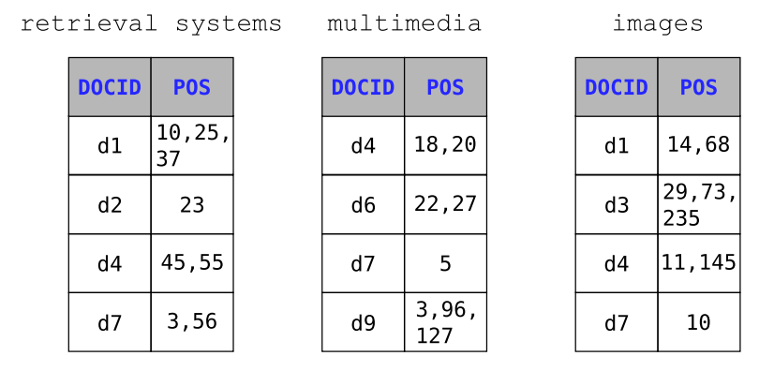
Other Examples Inverted Index (with positions of occurrence)

Slide 66
The Boolean & Extended Boolean Models
Retrieval Model

Slide 67
Boolean queries: More general merges
Sec. 1.3
Two steps (from AND example earlier):
Build inverted list: Locate terms in the Dictionary and retrieval their postings
Merge postings: map Boolean operators to set operators applied on inverted lists
AND: Intersection
OR: Union
NOT: Minus

Slide 68
The Key operation of retrieval: Merging
Sec. 1.3
Exercise: Adapt the merge for the queries:
Brutus AND NOT Caesar
Brutus OR NOT Caesar
(Brutus OR Caesar) AND NOT (Antony OR Cleopatra)
What about an arbitrary Boolean formula?
Can we still run through the merge in time O(x+y)? What can we achieve?
Can we always merge in “linear” time?
Can we do better?

Slide 69
Query Optimization
Sec. 1.3
What is the best way for query processing?
Consider a query that is an AND of n terms.
For each of the n terms, get its postings, then AND (intersect) them together.
Brutus
2
4
8
16
32
64
128
Caesar
1
2
3
5
8
16
21
34
Calpurnia
13
16
Query: Brutus AND Calpurnia AND Caesar

Slide 70
Query optimization example
Sec. 1.3
Process in order of increasing freq:
start with smallest set, then keep cutting further.
This is why
document freq. was kept in dictionary
Brutus
2
4
8
16
32
64
128
Caesar
1
2
3
5
8
16
21
34
Calpurnia
13
16
Execute the query as (Calpurnia AND Brutus) AND Caesar.

Slide 71
Exercise
Recommend a query processing order for
Which two terms should we process first?
Term | Freq
eyes | 213312
kaleidoscope | 87009
marmalade | 107913
skies | 271658
tangerine | 46653
trees | 316812
(tangerine OR trees) AND
(marmalade OR skies) AND
(kaleidoscope OR eyes)

Slide 72
The general rule for Optimization
Get doc. freq.’s for all terms.
Estimate the size of each OR by the sum of its doc. freq.’s (conservative).
Process in increasing order of OR sizes.

Slide 73
Extended Boolean Models
Phrase and long phrases

Slide 74
Phrase Queries
Sec. 2.4
We want to be able to answer queries such as “stanford university” – as a phrase
Thus the sentence “I went to university at Stanford” is not a match.
The concept of phrase queries has proven easily understood by users; one of the few “advanced search” ideas that works
Many more queries are implicit phrase queries
For this, it no longer suffices to store only
<term : docs> entries

Slide 75
A first attempt: Biword indexes
Sec. 2.4.1
Index every consecutive pair of terms in the text as a phrase
For example the text “Friends, Romans, Countrymen” would generate the biwords
friends romans
romans countrymen
Each of these biwords is now a dictionary term
Two-word phrase query-processing is now immediate.

Slide 76
Longer phrase queries
Sec. 2.4.1
Longer phrases can be processed by breaking them down
stanford university palo alto can be broken into the Boolean query on biwords:
stanford university AND university palo AND palo alto
Without the docs, we cannot verify that the docs matching the above Boolean query do contain the phrase.
Can have false positives!

Slide 77
Extended biwords
Sec. 2.4.1
Parse the indexed text and perform part-of-speech-tagging (POST).
Bucket the terms into (say) Nouns (N) and articles/prepositions (X).
Call any string of terms of the form NX*N an extended biword.
Each such extended biword is now made a term in the dictionary.
Example: catcher in the rye
N X X N
Query processing: parse it into N’s and X’s
Segment query into enhanced biwords
Look up in index: catcher rye

Slide 78
Issues for biword indexes
Sec. 2.4.1
False positives, as noted before
Index blowup due to bigger dictionary
Infeasible for more than biwords, big even for them
Biword indexes are not the standard solution (for all biwords) but can be part of a compound strategy

Slide 79
Solution 2: Positional indexes
Sec. 2.4.2
In the postings, store, for each term the position(s) in which tokens of it appear:
<term, number of docs containing term;
doc1: position1, position2 … ;
doc2: position1, position2 … ;
etc.>

Slide 80
Positional index example
Sec. 2.4.2
<be: 993427;
1: 7, 18, 33, 72, 86, 231;
2: 3, 149;
4: 17, 191, 291, 430, 434;
5: 363, 367, …>
Which of docs 1,2,4,5
could contain “to be
or not to be”?
For phrase queries, we use a merge algorithm recursively at the document level
But we now need to deal with more than just equality

Slide 81
Processing a phrase query
Sec. 2.4.2
Extract inverted index entries for each distinct term: to, be, or, not.
Merge their doc:position lists to enumerate all positions with “to be or not to be”.
to:
2:1,17,74,222,551; 4:8,16,190,429,433; 7:13,23,191; ...
be:
1:17,19; 4:17,191,291,430,434; 5:14,19,101; ...
Same general method for proximity searches

Slide 82
Proximity queries
Sec. 2.4.2
LIMIT! /3 STATUTE /3 FEDERAL /2 TORT
Again, here, /k means “within k words of”.
Clearly, positional indexes can be used for such queries; biword indexes cannot.
Exercise: Adapt the linear merge of postings to handle proximity queries. Can you make it work for any value of k?
This is a little tricky to do correctly and efficiently
See Figure 2.12 of IIR

Slide 83
Positional index size
Sec. 2.4.2
A positional index expands postings storage substantially
Even though indices can be compressed
Nevertheless, a positional index is now standardly used because of the power and usefulness of phrase and proximity queries … whether used explicitly or implicitly in a ranking retrieval system.

Slide 84
Positional index size
Sec. 2.4.2
Need an entry for each occurrence, not just once per document
Index size depends on average document size
Average web page has <1000 terms
SEC filings, books, even some epic poems … easily 100,000 terms
Consider a term with frequency 0.1%
Why?
Document size
Postings
Positional postings
1000
1
1
100,000
1
100

Slide 85
Rules of thumb
Sec. 2.4.2
A positional index is 2–4 as large as a non-positional index
Positional index size 35–50% of volume of original text
Caveat: all of this holds for “English-like” languages

Slide 86
Combination schemes
Sec. 2.4.3
These two approaches can be profitably combined
For particular phrases (“Michael Jackson”, “Britney Spears”) it is inefficient to keep on merging positional postings lists
Even more so for phrases like “The Who”
Williams et al. (2004) evaluate a more sophisticated mixed indexing scheme
A typical web query mixture was executed in ¼ of the time of using just a positional index
It required 26% more space than having a positional index alone

Slide 87
Examples IR system using Boolean model

Slide 88
Example: WestLaw http://www.westlaw.com/
Sec. 1.4
Largest commercial (paying subscribers) legal search service (started 1975; ranking added 1992; new federated search added 2010)
Tens of terabytes of data; ~700,000 users
Majority of users still use boolean queries
Example query:
What is the statute of limitations in cases involving the federal tort claims act?
LIMIT! /3 STATUTE ACTION /S FEDERAL /2 TORT /3 CLAIM
/3 = within 3 words, /S = in same sentence

Slide 89
Example: WestLaw http://www.westlaw.com/
Sec. 1.4
Another example query:
Requirements for disabled people to be able to access a workplace
disabl! /p access! /s work-site work-place (employment /3 place
Note that SPACE is disjunction (OR), not conjunction (AND)!
Many professional searchers still like Boolean search
You know exactly what you are getting
But that doesn’t mean it actually works better….

Slide 90
Summary
Boolean Model is a simple retrieval model based on set theory and boolean algebra. Queries are designed as boolean expressions which have precise semantics. The retrieval strategy is based on binary decision criterion. The boolean model considers that index terms are present or absent in a document.

Slide 91
Term-Document’s presentation
Consider 5 documents with a vocabulary of 6 terms
document 1 = ‘ term1 term3 ‘
document 2 = ‘ term 2 term4 term6 ‘
document 3 = ‘ term1 term2 term3 term4 term5 ‘
document 4 = ‘ term1 term3 term6 ‘
document 5 = ‘ term3 term4 ‘

Slide 92
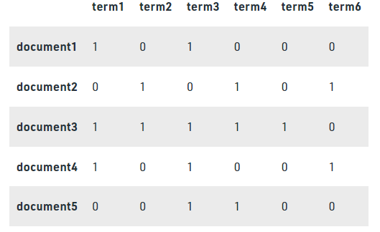
Documents represented in a boolean model

Slide 93
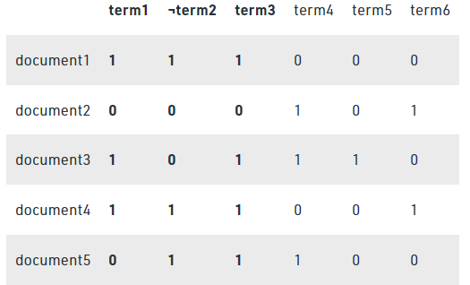
Query
Consider the query: Find the document consisting of term1 and term3 and not term2 ( term1 ∧ term3 ∧ ¬ term2)

Slide 94
Result
document 1 : 1 ∧ 1∧ 1 = 1
document 2 : 0 ∧ 0 ∧ 0 = 0
document 3 : 1 ∧ 1 ∧ 0 = 0
document 4 : 1 ∧ 1 ∧ 1 = 1
document 5 : 0 ∧ 1 ∧ 1 = 0
Based on the above computation document1 and document4 are relevant to the given query
Python code showing the implementation of the boolean model for document retrieval
https://www.geeksforgeeks.org/document-retrieval-using-boolean-model-and-vector-space-model/

Slide 95
Critical thinking
Accumulated evidence: 0 occurrence VS. 1 or multiple occurrences. YES/NO, once and repeated times.
Usually more seems stranger and better matches.
So, apart from phrases (byword) and location, we also need “Frequency”
Ranking search results: Boolean queries give inclusion or exclusion of docs.
Often we want to rank/group results
Need to measure proximity from query to each doc.

